Slide 1
The Quantum Fourier Transform and Its Applications
Claire Yang
ER RA CSP
2019-03-19

Slide 2
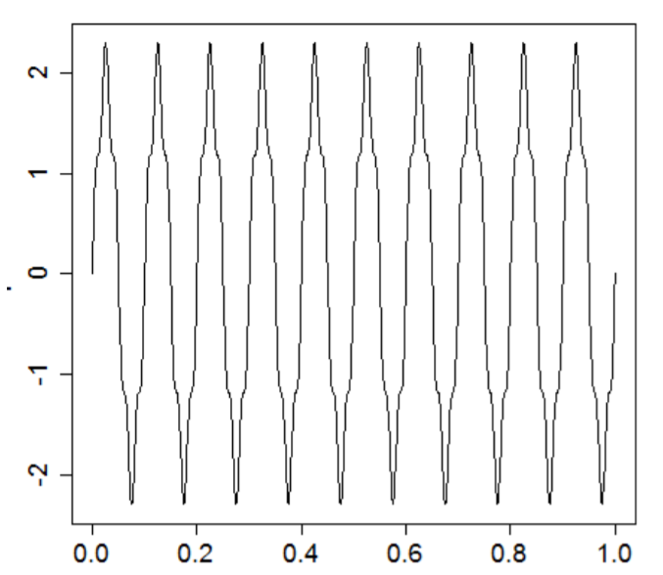
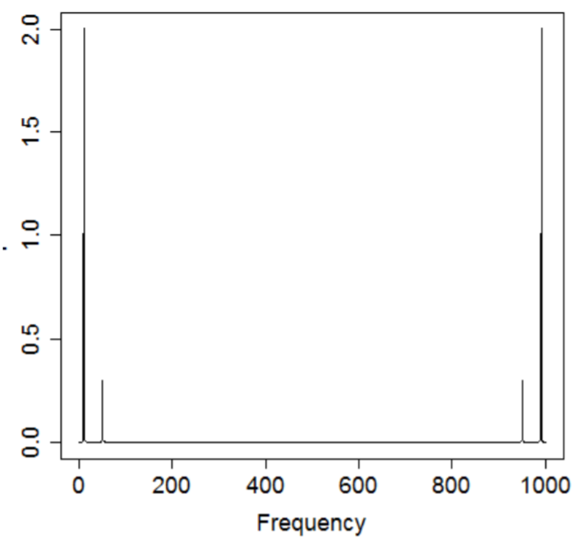
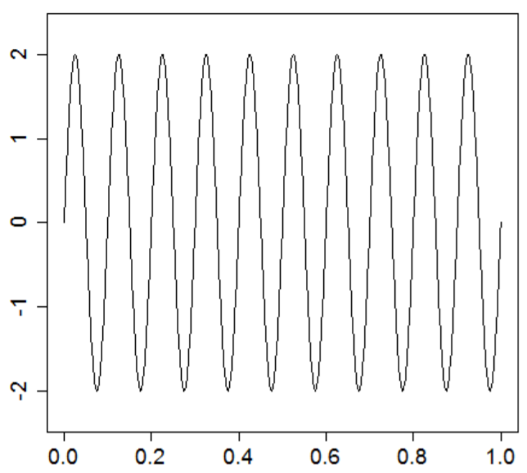
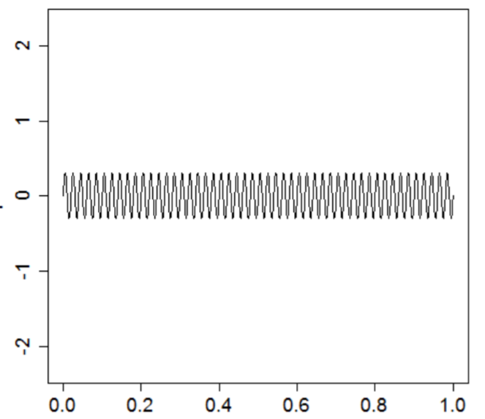
Discrete Fourier Transform
Input signal
Input signal in frequency domain
QFT is the quantum analogue of DFT:
Map signal from time domain to frequency domain on quantum computer with a faster speed
Basis for quantum phase estimation
True signal: f=10, A=2
Noise signal: f=50, A=0.3
Pictures: https://arxiv.org/pdf/1804.10068.pdf
Notes:
We all know that discrete Fourier transform is a very important technique, which can map a signal from time domain to frequency domain, and it is widely used in the field of telecommunication. For example, we have a signal with frequency 10Hz, but interferenced by a noise signal with frequency 50Hz. In the time domain, it is very hard for us to get rid of the noise, but if we use the discrete Fourier transform to transfer it into frequency domain, we can easily get the true signal by using a low-pass filter. Then we can transfer the signal back to time domain by using inverse DFT.
(PS. The mirrored peaks at frequency 950 and 990 are just the result of using complex numbers.)
Quantum Fourier transform is the quantum analogue of discrete Fourier transform, which can map the signal from time domain to frequency domain with a much faster speed, even exponentially faster than the fast Fourier transform.
What’s more, it can also be part pf the quantum phase estimation algorithm, which is one of the fundamental algorithms for quantum machine learning.

Slide 3
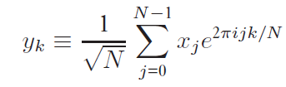
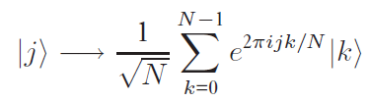





Quantum Fourier Transform
Input
Output
$$x_{1}, x_{2}, …, x_{N}$$
DFT:
$$y_{1}, y_{2}, …, y_{N}$$
Length: N
Length: N
$$|\left.x_{1}, x_{2}, …, x_{n}\right\rangle$$
QFT:
$$|\left.y_{1}, y_{2}, …, y_{n}\right\rangle$$
Length: n
Length: n
$$N= 2^{n}$$
Notes:
Then I’d like to compare the mathematical notation for DFT and QFT. The DFT takes an complex vector with length N as an input, and has the output with the same length.
The QFT is exactly the same transformation. However the input and output is different. If we have a input for DFT with N bits and output with same length, it means that the length of corresponding QFT input and output should be length lower case of n, and their relationship is…
Thus QFT takes much less qubits, compared with DFT.

Slide 4
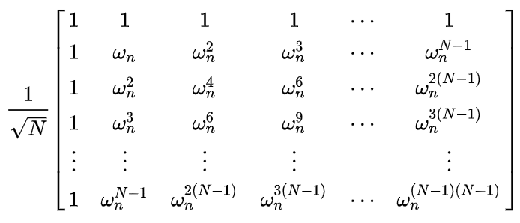

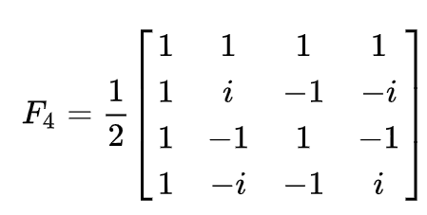


Quantum Fourier Transform
QFT:
$$|\left.x_{1}, x_{2}, …, x_{n}\right\rangle$$
$$|\left.y_{1}, y_{2}, …, y_{n}\right\rangle$$
Length: n
Length: n
N×N matrix
where
Example (2 qubits):
Notes:
You probably already know that there are many quantum gates, which can transform quantum states to the other quantum states, and they are unitary operaters. Similarly, the QFT operation can also be realized by a unitary operator, which can be written as the N by N matrix like this, where wn is...
Here is an example for a 2-qubit QFT gate.

Slide 5
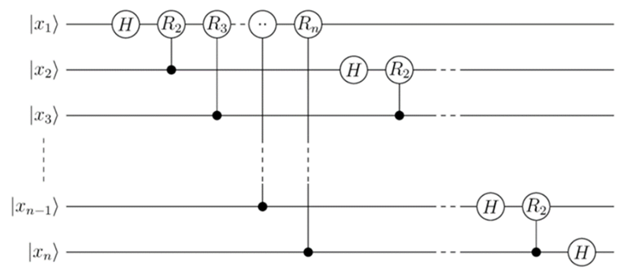
Quantum Fourier Transform
QFT:
$$|\left.x_{1}, x_{2}, …, x_{n}\right\rangle$$
$$|\left.y_{1}, y_{2}, …, y_{n}\right\rangle$$
Length: n
Length: n
Quantum circuit for QFT
Picture: https://www.wikiwand.com/en/Quantum_Fourier_transform
Notes:
And the QFT gate can be represented by a set of simpler quantum gates, which is like this. This is what we call the quantum circuit.
If you go through the mathematical derivation of this equation, you will find out that the layout of the circuit is corresponding with it.

Slide 6
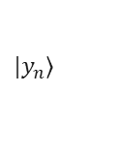
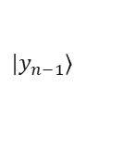

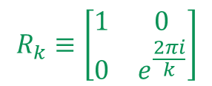

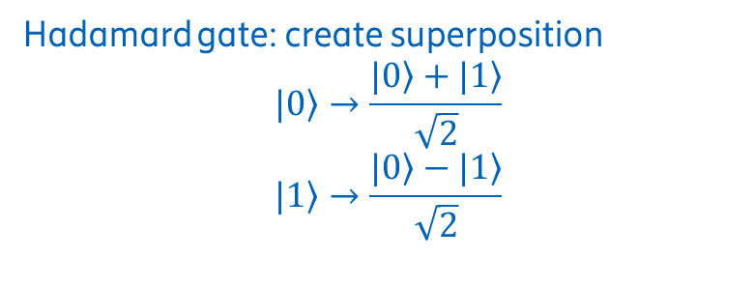
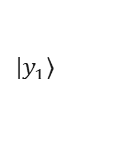

Quantum Fourier Transform
Quantum circuit for QFT
$$|\left.y_{1}\right\rangle$$
$$|\left.y_{2}\right\rangle$$
$$|\left.y_{3}\right\rangle$$
$$|\left.y_{n−1}\right\rangle$$
$$|\left.y_{n}\right\rangle$$
Hadamard gate: create superposition
$$|\left.0\right\rangle →\frac{|\left.0\right\rangle +|\left.1\right\rangle }{\sqrt{2}}$$
$$|\left.1\right\rangle →\frac{|\left.0\right\rangle −|\left.1\right\rangle }{\sqrt{2}}$$
Controlled phase gate
Target qubit
$$R_{k}$$
$$R_{k}≡\left[\begin{matrix}1 & 0 \\ 0 & e^{\frac{2πi}{k}}\end{matrix}\right]$$
Control qubit
Picture: https://www.wikiwand.com/en/Quantum_Fourier_transform
Notes:
And the QFT gate can be represented by a set of simpler quantum gates, which is like this. This is what we call the quantum circuit.
The Hadamard gate is widely used to create superposition. It can transform the 0 or 1 into a qubit that can stay in both 0 and 1 at the same time. And after we measure it, we can only get one state back with equal probability.
The controlled phase gate act on the target qubit, but is controlled by the control qubit. If the control qubit is 0, then the target qubit doesn’t make any change. However, if the control qubit is 1, the phase shift operator will be applied on the qubit.

Slide 7
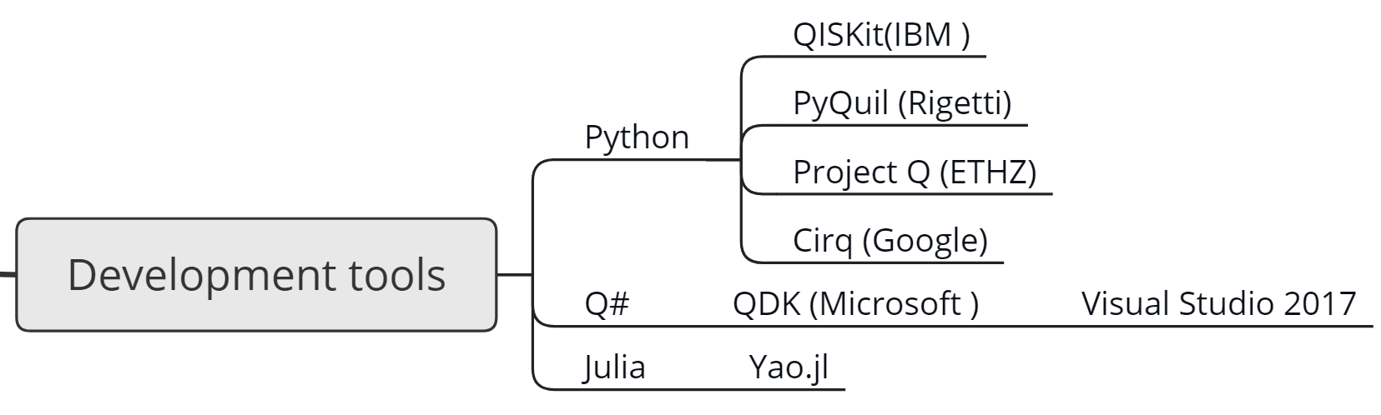
Development tools
Notes:
Even though a viable quantum computer doesn’t even exist yet, there are still several ways for us to get involved.
For example, the Q# designed by Microsoft. It needs C# as a driver, and we can just use Visual Studio for programming.
Yao.jl is a package based on Julia developed by a Chinese team.
And there are also several open source quantum computing framework based on python, such as QISKit, PyQuil and ProjectQ.
Among these I found the QISKit designed by IBM is the easiest to use. It includes not only the quantum gates, but some tools to draw quantum circuits. And becasue it’s based on Python, we can use Matplotlib to realize the visualization of results. And QISKit has opened a cloud service to public, allowing us to freely run quantum algorithms on a real quantum chip.

Slide 8
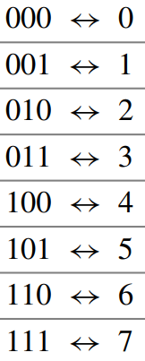


Implementation and comparison with iFFT
Python
(8-bit)
iFFT Algorithm
$$0100 0000$$
Step 1.
Compareoutput
(wave function)
One-hot encoding
Local Simulator
QFT Algorithm
IBM Quantum Chip
$$|\left.001\right\rangle$$
(3-qubit)
IBM QISKit
QFT = iFFT, iQFT = FFT
Notes:
Now we know the principle of QFT, thus we can implement it and compare it with classical algorithm. FFT is the fastest classical algorithm for discrete fourier transform. Thus I would like to compare it with the quantum Fourier transform. This is the structure.
If we input a bit string 0100 0000 into the FFT system, it is equal to we input a qubit string 001 into QFT system. The relationship between input bitstring and qubit string is very similar to the one-hot encoding in Machine learning. We get a 1 in the 1st position here, so we input a binary 1 there.
And for QFT system, we can choose to use our local laptop as a simulator, or get access to IBM’s quantum chip remotely.
The first step for this experiment is to compare the output of two systems, to see if their results are they same.
Result shows that the two system have the same output. Attention: QFT has the same output with iFFT, while iQFT has the same output with FFT (compare the wavefunction). I read this from some websites, but still haven’t figured out why.

Slide 9


Implementation and comparison with iFFT
Python
(8-bit)
iFFT Algorithm
$$0100 0000$$
2.96 $μs$
Step 2.
Compare running time
One-hot encoding
Local Simulator
QFT Algorithm
IBM Quantum Chip
$$|\left.001\right\rangle$$
(3-qubit)
IBM QISKit
$t_{measure}=t_{queue}+t_{run}$
11.7s
11.2s
Notes:
But when I try to compare the actual running time of QFT and FFT, I met a problem. I try to measure the running time of QFT on the quantum chip. But what we measure is with another term, queuing time.
So I try to measure the queuing time by running a null operation on this quantum chip. However the queuing time is very long, more than 10 seconds. But the time for running a FFT process is only around 3 microseconds. Thus there must be a huge error in our measurement. We need to search for further solution.

Slide 10
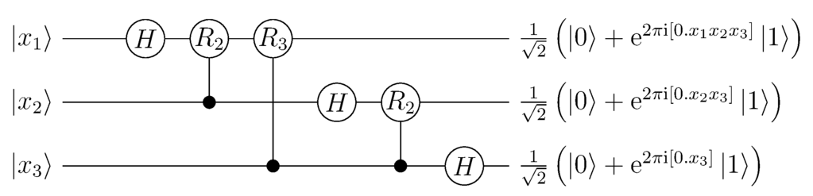
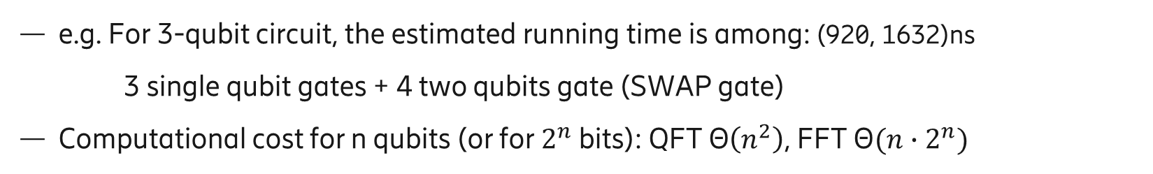
Estimation of the QFT running time
Add up the delays on the longest path of the compiled circuit
Single qubit gate: 80 ns, two qubits gate: 170<t<348 ns
SWAP gate
e.g. For 3-qubit circuit, the estimated running time is among: (920, 1632)ns
3 single qubit gates + 4 two qubits gate (SWAP gate)
Computational cost for n qubits (or for $2^{n}$ bits): QFT Θ$\left(n^{2}\right)$, FFT $\text{Θ}({n∙2}^{n})$
Picture: https://www.wikiwand.com/en/Quantum_Fourier_transform
Notes:
For example in our 3-qubit experiment, there are in total 6 sigle qubit gates, and this circuit eliminate a 2-qubit gate, which is to SWAP ´the first and third gate. Then the estimated running time for this circuit is 160ns.
Later we can do more experiments on the comparison of QFT and FFT, to use different number of qubits and draw a curve to see if there is an exponential speedup.

Slide 11
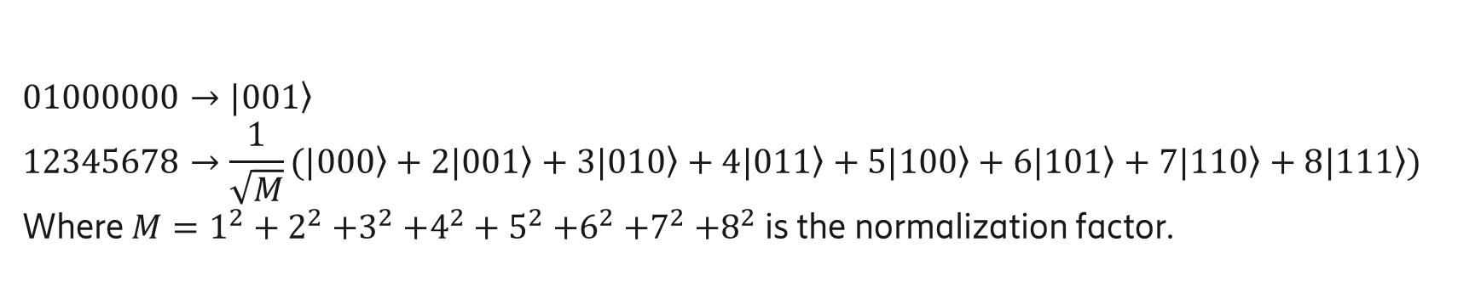
Real cases usage
The algorithm itself is easy to be generalized from 3-qubit to n-qubit.
But it is hard to create a complex enough input qubit string, e.g. Sine wave.
Example:
$$01000000→|\left.001\right\rangle$$
$$12345678→\frac{1}{\sqrt{M}}(|\left.000\right\rangle +2|\left.001\right\rangle +3|\left.010\right\rangle +4|\left.011\right\rangle +5|\left.100\right\rangle +6|\left.101\right\rangle +7|\left.110\right\rangle +8|\left.111\right\rangle )$$
Where ${M=1}^{2}+2^{2}{+3}^{2}{+4}^{2}+5^{2}{+6}^{2}+7^{2}{+8}^{2}$ is the normalization factor.
Picture: https://www.wikiwand.com/en/Quantum_Fourier_transform
Notes:
How can we use QFT into real cases? In real problems, of course the bit string is much more caomplex than our previous examples.
This quantum Fourier transform actually can be easily generalized into n-qubit case, because as you can see the quantum circuit is very neat.
However, the hardest part is to create a complex enough input for the algorithm.

Slide 12
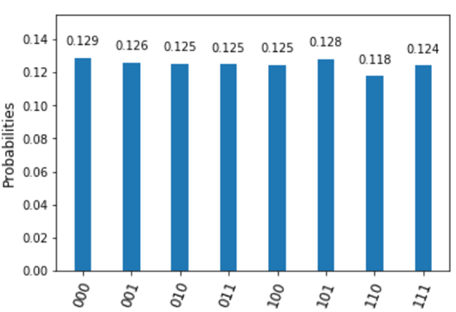
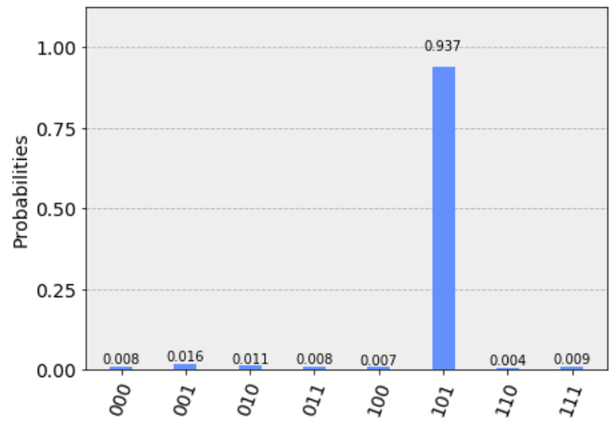
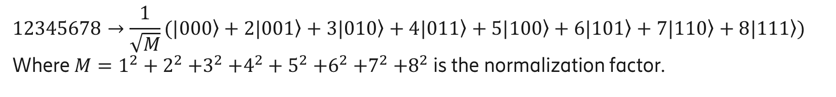
Real cases usage
$$12345678→\frac{1}{\sqrt{M}}(|\left.000\right\rangle +2|\left.001\right\rangle +3|\left.010\right\rangle +4|\left.011\right\rangle +5|\left.100\right\rangle +6|\left.101\right\rangle +7|\left.110\right\rangle +8|\left.111\right\rangle )$$
Where ${M=1}^{2}+2^{2}{+3}^{2}{+4}^{2}+5^{2}{+6}^{2}+7^{2}{+8}^{2}$ is the normalization factor.
Use Hadamard gates
Grover’s search
Picture: https://github.com/Qiskit/qiskit-tutorials/blob/master/community/algorithms/grover_algorithm.ipynb
Notes:
Hadamard gates can only create an input with quantum states with equal probability. But if you want to create an input quantum string with the weights that you interest, it is very hard.
Just like the grover’s search algorithm, is to make the probability of the state we want to be biggest, and close to 1, creating a special quantum input like this is a process of generating a probability distribution we want. Thus, the process of input generation can sometimes be as hard as the quantum computing algorithm.
However this is a hard point for almost all algorithms, and we will keep working on this.

Slide 13
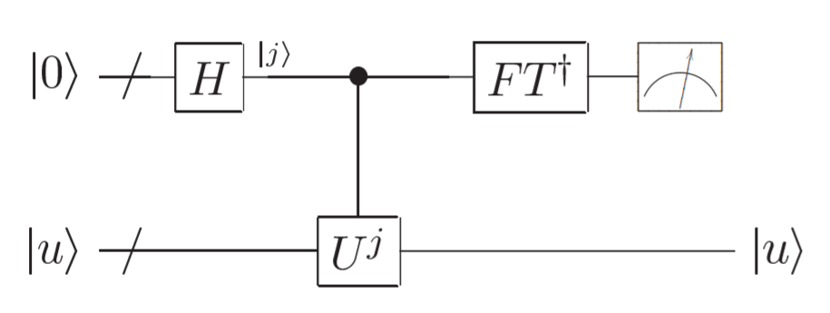
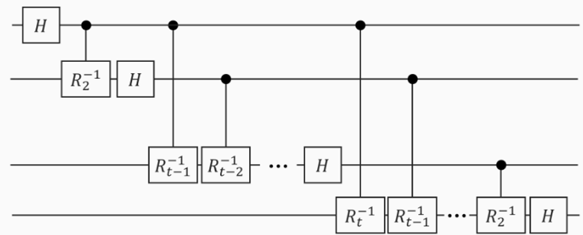
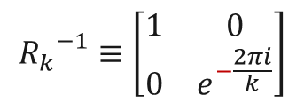
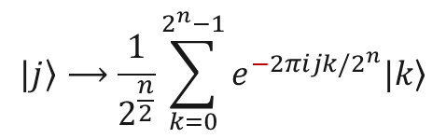
Application: Quantum Phase Estimation
Quantum phase estimation: to calculate the eigenvalue of U
Inverse quantum Fourier transform:
Controlled-U gate
$$|\left.j\right\rangle ⟶\frac{1}{2^{\frac{n}{2}}}\sum_{k=0}^{2^{n}−1}{e^{−2πijk/2^{n}}|\left.k\right\rangle }$$
$${R_{k}}^{−1}≡\left[\begin{matrix}1 & 0 \\ 0 & e^{−\frac{2πi}{k}}\end{matrix}\right]$$
Picture: https://www.qtumist.com/info/PE-H5/index.html
Notes:
Here the inverse QFT is different from QFT. The phase shift is with an additional minus here.

Slide 14
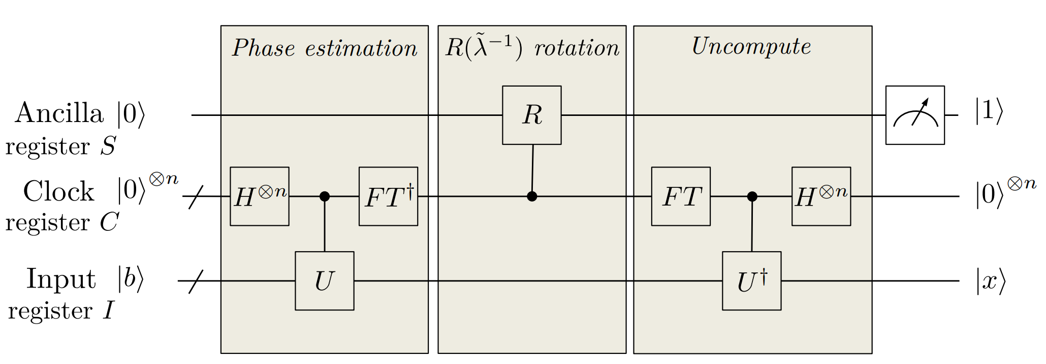

Application: HHL Algorithm - Quantum algorithm for linear systems of equations
Solve $\vec{A}x=\vec{b}$ using a quantum computer
Phase estimation
Reverse phase estimation
Picture: https://arxiv.org/pdf/1802.08227.pdf

Slide 15
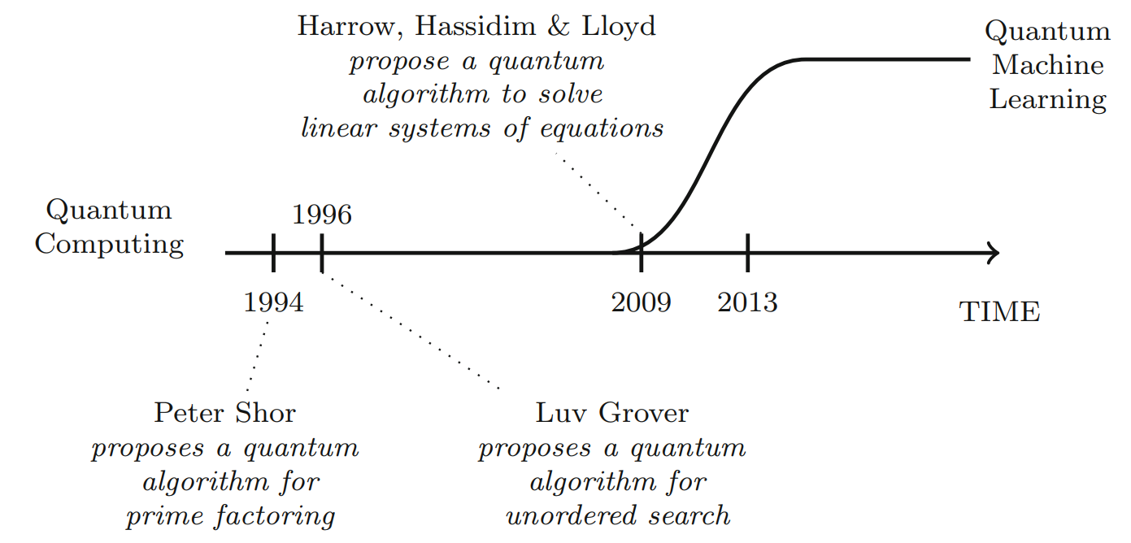
Application: HHL Algorithm- Milestone for QML
Usage: quantum machine learning algorithms including bayesian inference, qSVM, qPCA...
Picture: M. Schuld and F. Petruccione. Supervised learning with quantum computers. Springer, 2018.
Notes:
HHL is a very important algorithm, which can be used to realize many quantum machine learning algorithms like... It acts as a milestone in the world of Quantum Computing, and makes QML a new subdiscipline of quantum computing.
Not only the quantum Fourier transform is important itself, but also it can be used as the fundamental unit of so many other quantum algorithms.

Slide 16
Materials
Books:
Quantum Computation and Quantum Information, 2002
Quantum Machine Learning: What Quantum Computing Means to Data Mining, 2014
Supervised Learning with Quantum Computers, 2018
Online courses:
edX & University of Toronto: Quantum Machine Learning
edX & TU Delft: Quantum Cryptography
edX TUDelft: The building blocks of a quantum computer I
edX TUDelft: The building blocks of a quantum computer II

Slide 17
Thanks for listening

